Slide 1
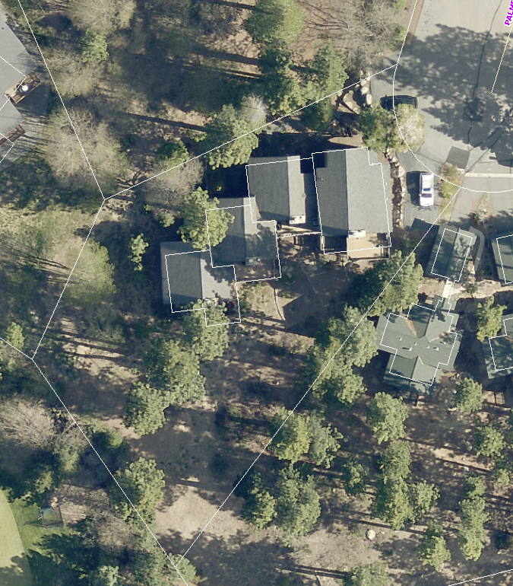
WPVAR17-0004 (Greenview HOA)
Washoe County Board of Adjustment
August 3, 2017

Slide 2
Background
Subject property is zoned LDU (Low Density Urban)
- 15 foot front and rear setbacks and 5 foot side yard setback
Greenview is a 4 unit condominium located on a cul-de-sac that was built in 1979 without garages
The variance is requesting a reduction to the front yard setback (from 15 feet to 1 foot) and the side yard setback (from 5 feet to 1 foot)
Proposal is for 2 double car garages in the common area

Slide 3
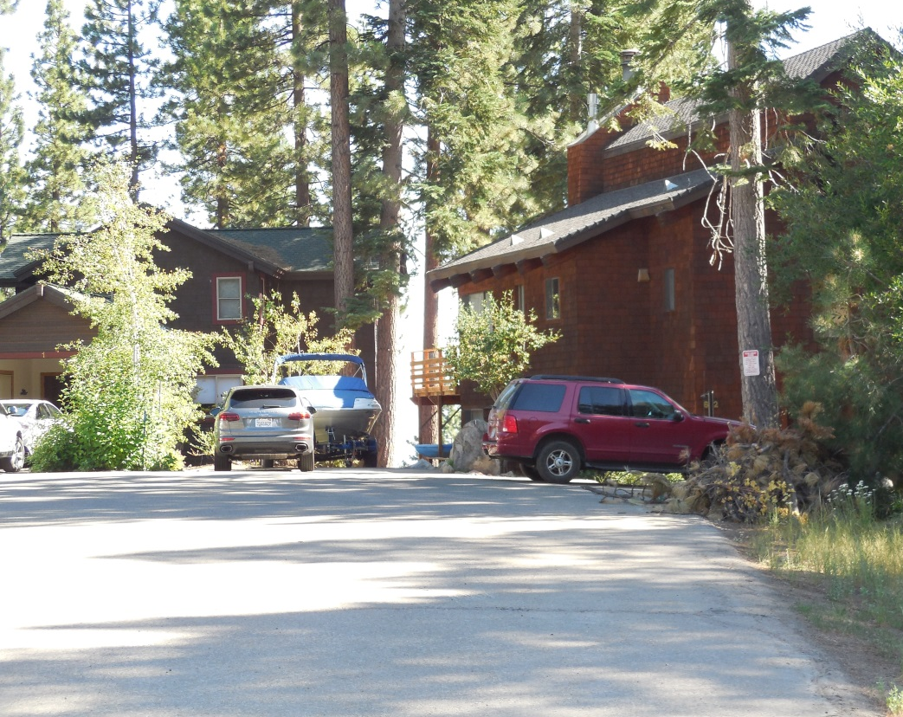
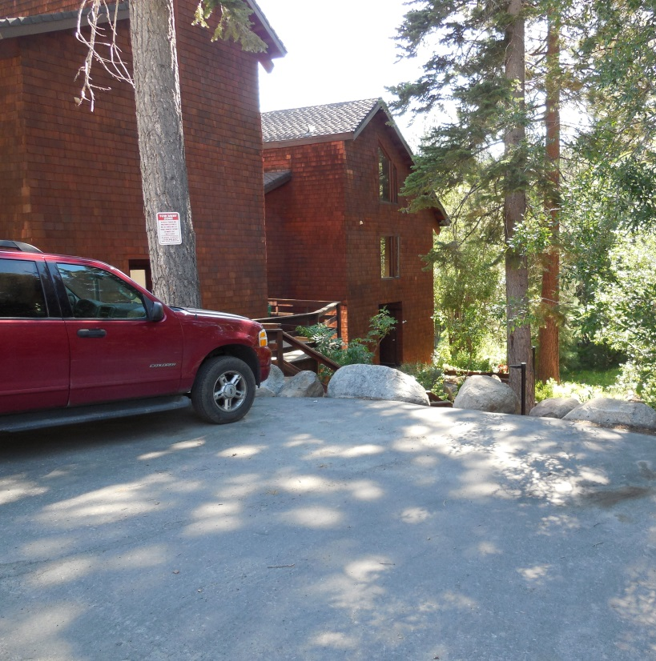
Background
Existing parking is on the public street with a small parking area adjacent to unit 1

Slide 4
Existing Site Plan

Slide 5
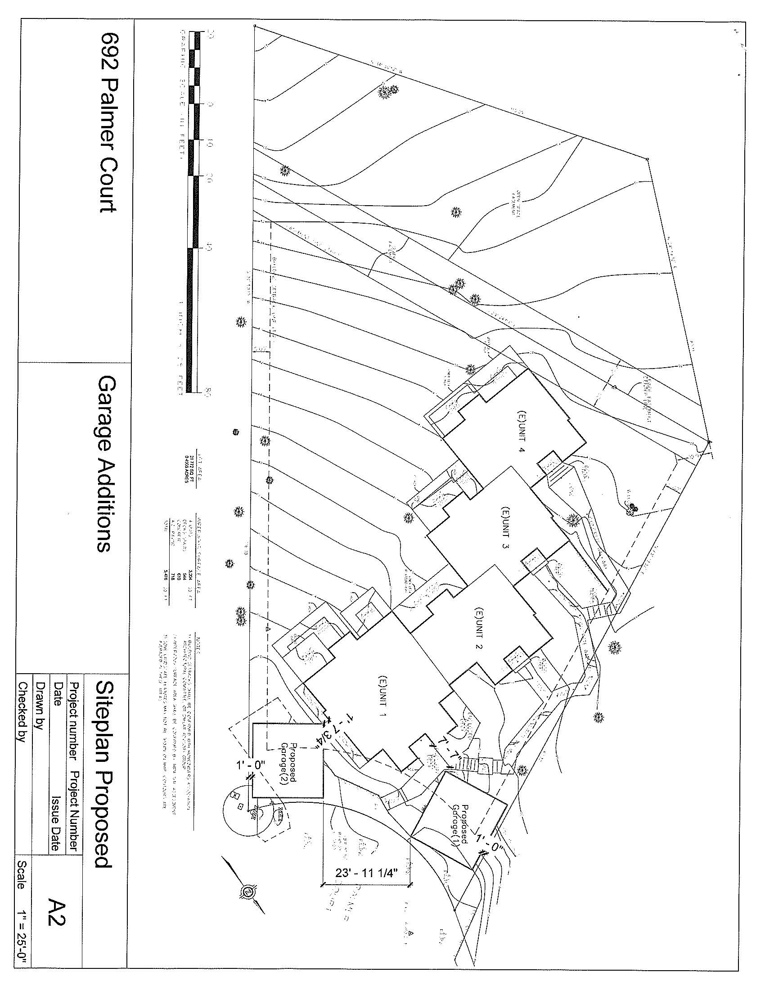
Proposed Site Plan

Slide 6
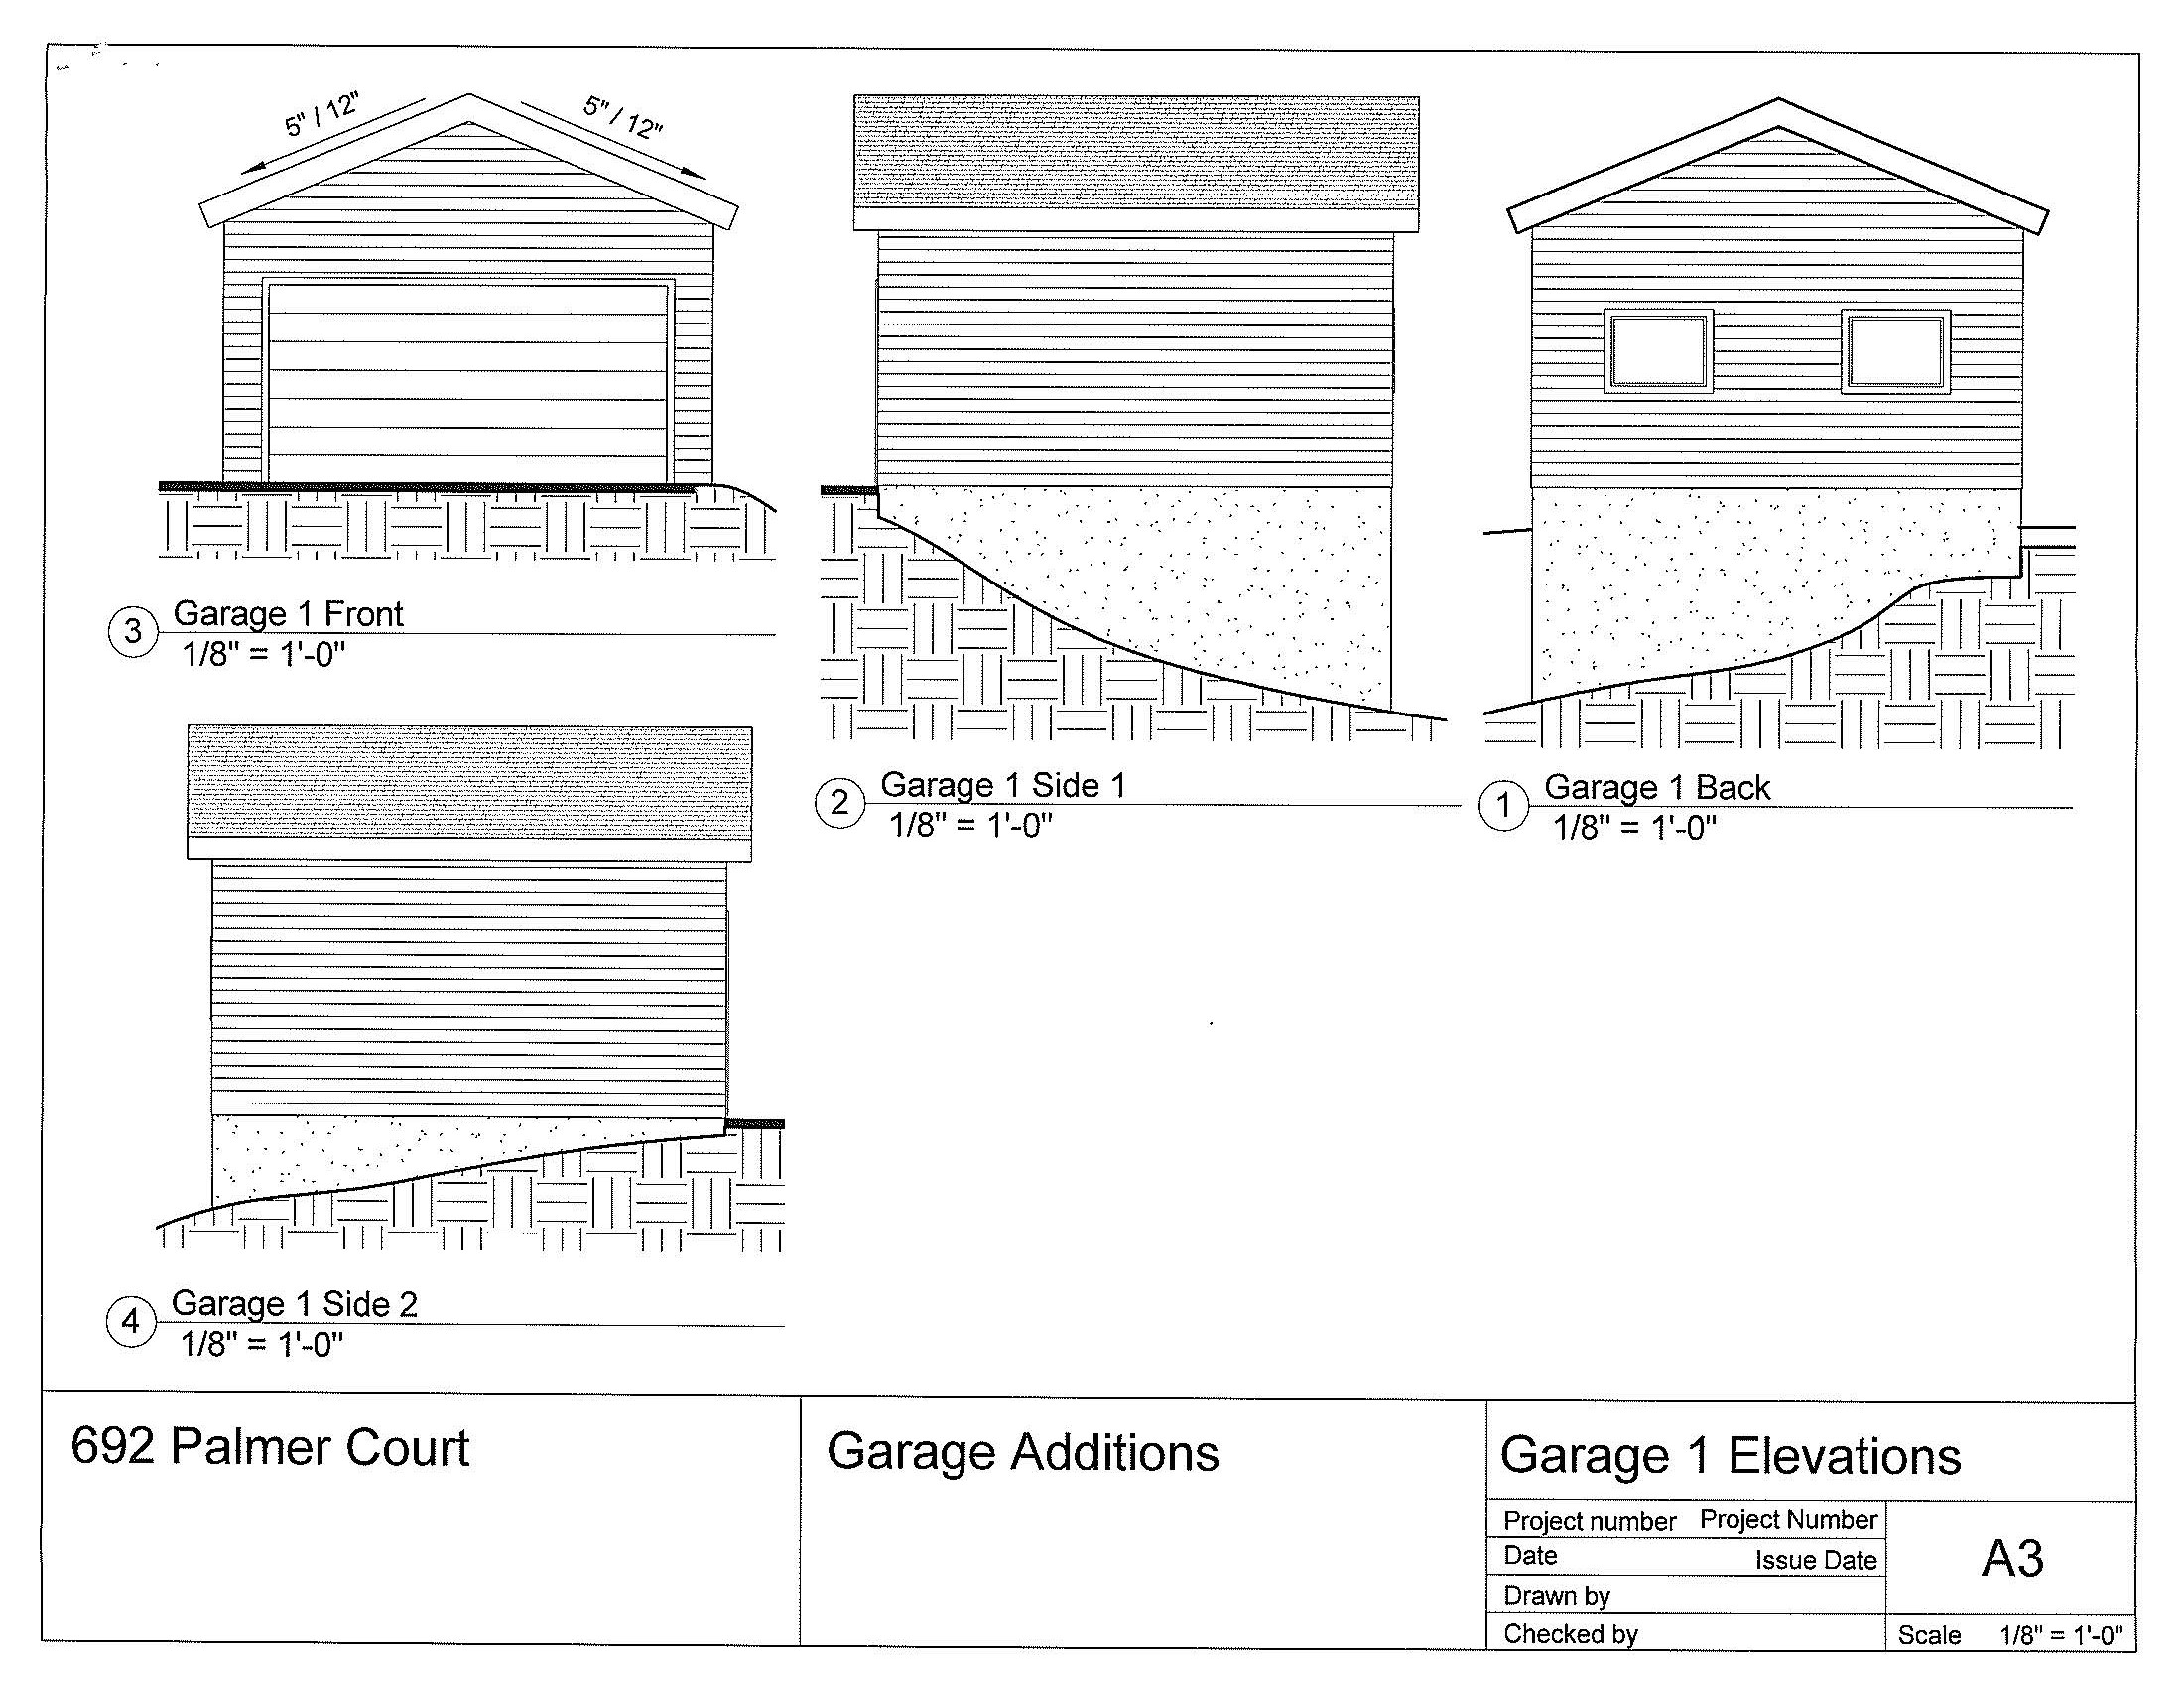
Proposed garages 1 elevation

Slide 7
Proposed garages 2 elevations

Slide 8
Analysis
The parcel is wedge shaped and the narrowest part of the parcel is located along the cul-de-sac
There is an open space and a sewer easement that crosses the rear of the property just below the condominium units
Currently the condominiums have no garages
Parking for the condominium is only on the street
Neighboring properties on the cul-de-sac have garages

Slide 9
Analysis
Special circumstances exist (topography, easements, and lack of access to the rear of the property)
No detriment to the public good and will provide off street parking
No grant of special privileges- neighboring properties have garages
The authorized use will conform closer to code requirements addressing garages for residences

Slide 10
Reviewing Agencies
Washoe County Community Services Department
Planning and Building Division
Planning Program
Building Program
Engineering and Capital Projects Division
Land Development
Operations Division
Incline Village Roads Department
Washoe County Health District
Air Quality Management Division
Environmental Health Services Division
Incline Village General Improvement District
North Lake Tahoe Fire Protection District
Nevada Tahoe Conservation District
US Forest Service
Regional Transportation Commission
Charter Communications

Slide 11
Reviewing Agencies
5 out of the 15 reviewing agencies provided conditions of approval:
Washoe County
Planning and Building Division
Engineering and Capitol Projects Division, Land Development
Incline Village General Improvement District
See Exhibit A of the staff report for the recommended conditions of approval

Slide 12
Citizen Advisory Board/Public Comment
The Incline Village/Crystal Bay Citizen Advisory Board reviewed the project at its July 24th meeting.
Two abutting property owners spoke in opposition to the garage closet to them
The CAB recommended denial on a 5 – 1 vote
There are 2 emails from the neighboring properties and 1 from the applicant include in the staff report
Other emails that have been received and forwarded to the Board or distributed to the Board today

Slide 13
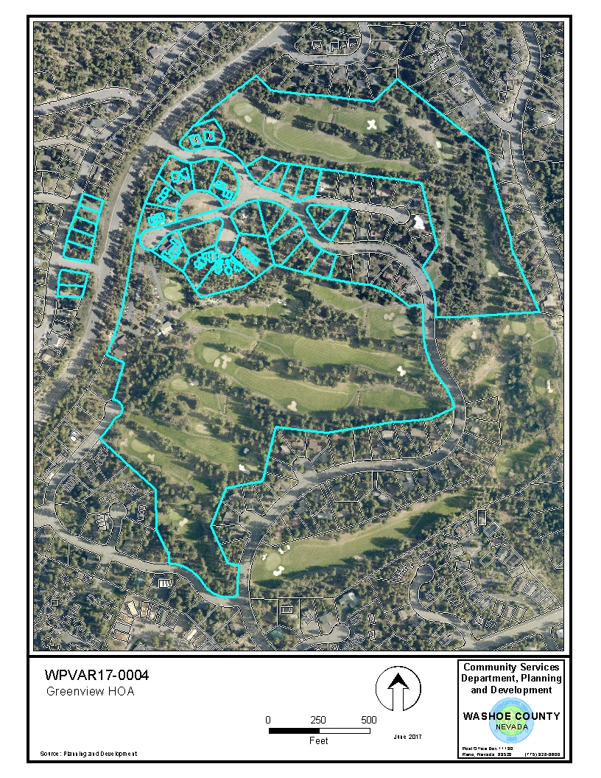
A total of 49 properties within 500 feet were noticed
Subject property

Slide 14
Required Findings
WCC Section 110.804.25, Variance Findings:
Special Circumstances (Exceptional narrowness, exceptional topography, exceptional situation)
No detriment
No special privileges
Use authorized
Effect on Military Installation

Slide 15
Required Findings
Staff analysis is provided in the staff report starting on page 6
Staff is able to make all of the required findings

Slide 16
Staff Recommendation
After a through analysis and review, Variance Case Number WPVAR17-0004 for Greenview HOA is being recommended for approval with conditions.

Slide 17
Possible Motion
I move that, after considering the information contained within the staff report and the information received during the public hearing, the Washoe County Board of Adjustment approve, with the conditions included at Exhibit A to the staff report for this item, Variance Case Number WPVAR17-0004 for Greenview HOA, being able to make the findings required by Washoe County Code Section 110.804.25 for approval of Variances.

Slide 18
Appeal Process
Board of Adjustment action will be effective 10 calendar days after the written decision is filed with the Secretary to the Board of Adjustment and mailed to the applicant, unless the action is appealed to the Washoe County Board of County Commissioners, in which case the outcome of the appeal shall be determined by the Washoe County Board of County Commissioners. Any appeal must be filed in writing with the Planning and Development Division within 10 calendar days after the written decision is signed by and filed with the Secretary to the Board of Adjustment, and mailed to the applicant.

